Slide 1

CET2011A -Operating Systems
School of Computer Engineering and technology

Slide 2

Lab Assignment 7 FIFO Page Replacement Algorithm
Problem Statement : Write a program to simulate the FIFO ( First In First Out) page replacement algorithm.

Slide 3
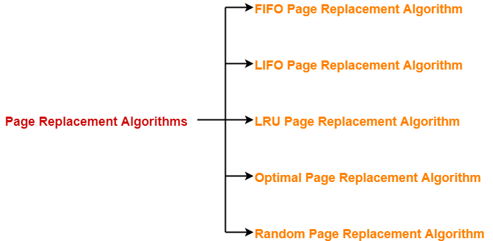
Page Replacement Algorithms

Slide 4
FIFO Page Replacement Algorithm

Slide 5
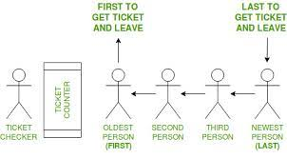
FIFO Page Replacement Algorithm
FIFO is a method of processing and retrieving data.
In a FIFO system, the first items entered are the first ones to be removed.
In this algorithm, the operating system keeps track of all pages in the memory in a queue, the oldest page is in the front of the queue. When a page needs to be replaced page in the front of the queue is selected for removal.

Slide 6
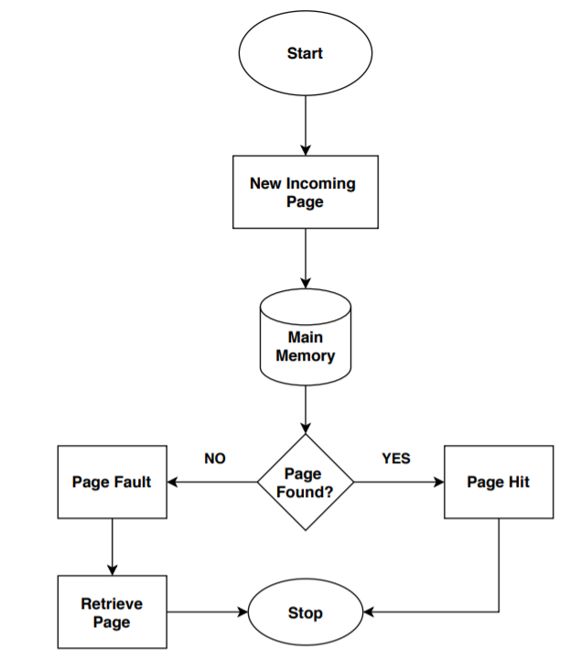
Page replacement algorithms like FIFO are used when there is a new page request, and there is not enough space in the main memory to allocate the new page.
Hence, a page replacement algorithm decides which page it should replace so that it can allocate the memory for the new page.
FIFO Page Replacement Algorithm

Slide 7
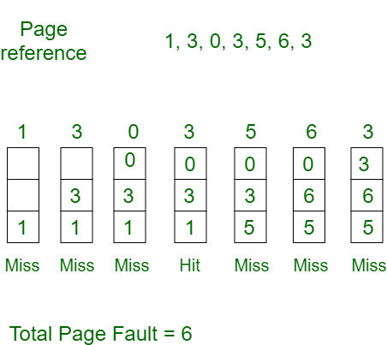
Example- Consider page reference string 1, 3, 0, 3, 5, 6 with 3 page frames. Find number of page faults.
Initially all slots are empty, so when 1, 3, 0 came they are allocated to the empty slots —> 3 Page Faults.
when 3 comes, it is already in memory so —> 0 Page Faults.
Then 5 comes, it is not available in memory so it replaces the oldest page slot i.e 1. —>1 Page Fault.
6 comes, it is also not available in memory so it replaces the oldest page slot i.e 3 —>1 Page Fault.
Finally when 3 come it is not avilable so it replaces 0 1 page fault

Slide 8
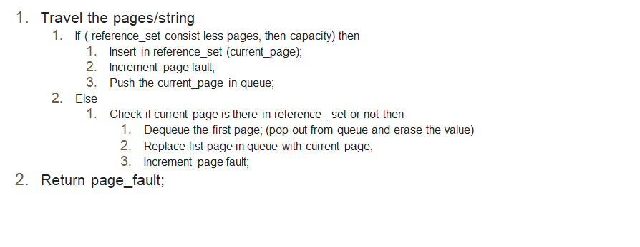
Pseudo Code

